Slide 1
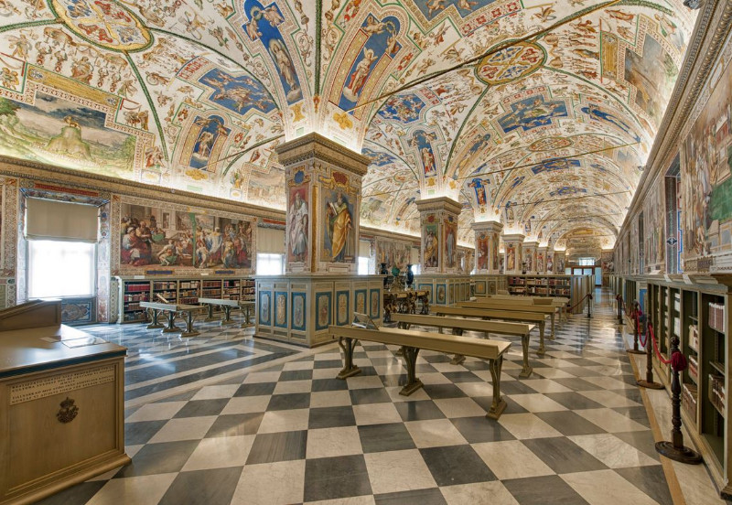
The Self-Study Report
2026-2027
Self-Study
Workshop
Jim Moore
ATS Director of Accreditation
1

Slide 2
The Self-Study Report is the story of your school,
particularly since your last (comprehensive) visit.
2

Slide 3
What makes a “good self-study report”?
Outline for this session:
I. It has a PURPOSE / (GOAL) – to tell your school’s story well (1)
II. It follows GUIDELINES – reflecting the Standards (bulk)
III. It produces RESULTS – (1)
  quality assurance to your school’s publics
  and improvement of your school’s educational & institutional effectiveness
3

Slide 4

I. PURPOSE (GOALS)
What do we most need to improve? Or what is our biggest challenge?
1) Internal goals
    Discuss key issue(s)
    Begin new strategic planning process
2) External goals
    Demonstrate educational quality to (ATS) peers
    Provides quality assurance to public(s) – current/future students, donors, etc.
3) Eternal goals
    Opportunity to reflect on what matters most to your mission
    Theological things with eternal consequences
Tell your story to sympathetic but objective strangers
(With Thanks to Tom Tanner)
4

Slide 5
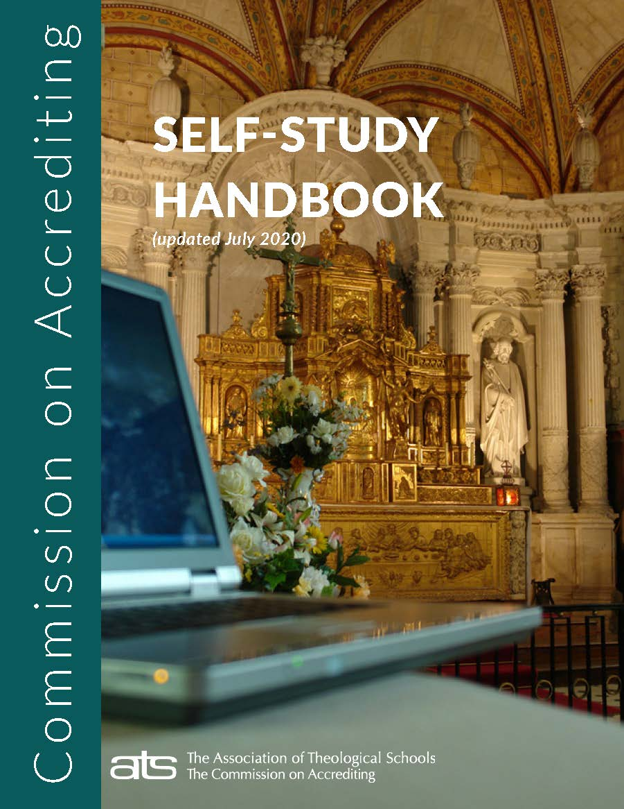
II. GUIDELINES reflecting the Standards of Accreditation
Self-Study Handbook
**Latest edition on the web!!!!!
& watch for further annual summer updates!
Introduction (history, educational principles, overview)
Part 1: The Self-Study Process (goals, organizing, resources)
Part 2: The Self-Study Report (characteristics, structure)
Part 3: The Self-Study Visit (before, during, after)
Appendices:
A. Links to Self-Study Resources
B. Requirements for US Title IV Participants
A Review
5

Slide 6
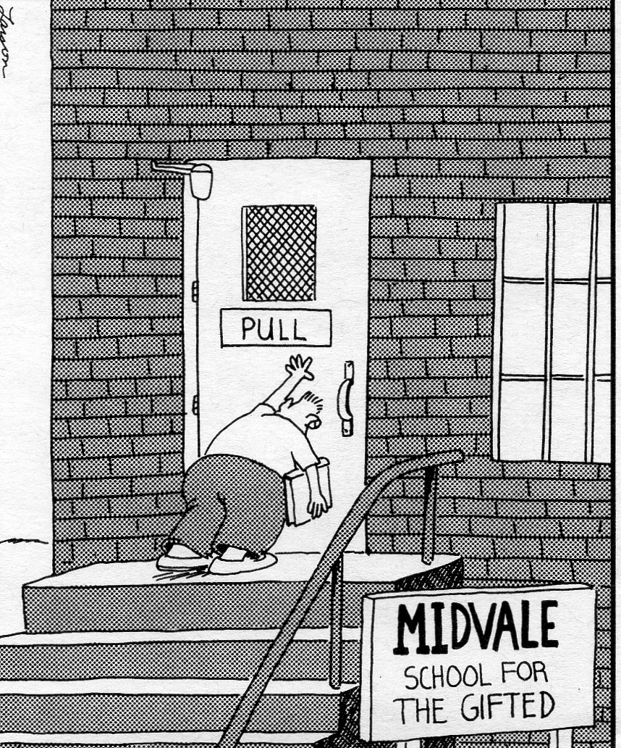
A caution . . .
No matter how gifted you are, follow the signs ☺!
ATS Resources
Self-Study Handbook
Standards with Self-Study Ideas
Standards of Accreditation
A Reflective Guide to Effective Evaluation your ATS liaison
6

Slide 7


The self-study report . . .
Five key characteristics
The specific report structure
7

Slide 8
Five key characteristics
The good self-study report is characterized by . . .
  Sufficient description
  Supporting data (evidence/documents)
  Evaluation of the gathered data
  Informed recommendations
  In light of the school’s mission and context
8

Slide 9
1) Sufficient description
For the reader to understand the school and process of the self-study
  Summary of school
  How did the process engage the school community (stakeholders)?
    Note: self-study not “farmed out” or the work of a few (or to gen-AI)
Tell your story to “sympathetic strangers” – peer evaluators, consultants (and BOC)
Standards in one hand, self-study in the other (objectivity)
Accurate description – looking in the mirror at “real you” vs through a stained-glass window at “rosy ideal” (reflection vs rose-colored-glasses)
Specific description (names, titles)
Evaluative description (what was effective or not?)
9

Slide 10
Sufficient description
Weak report: “We have sufficient faculty, and they are all well qualified.”
Good report: “We have seven full-time faculty; six have PhD degrees and one has a DMin (see Faculty Credentials in the Supplemental Materials for a detailed list).”
10

Slide 11
Sufficient description
Weak report: “Our SLAP efforts have produced significant improvements.”
Good report: “Our Student Learning Assessment Program (affectionately called SLAP by students) has produced these three improvements in student learning this past year. First, . . .”
11

Slide 12
2) Supporting data (evidence/documents)
Data crucial to understanding (not extraneous)
Clear and concise data
Use qualitative and quantitative data
Use tables and charts to support narrative
Caution
Use links for extensive data
But include summary data in the narrative
Links should be easy to use (avoid multiple passwords)
12

Slide 13
Supporting data (evidence/documents)
How many years should we cover?
13

Slide 14
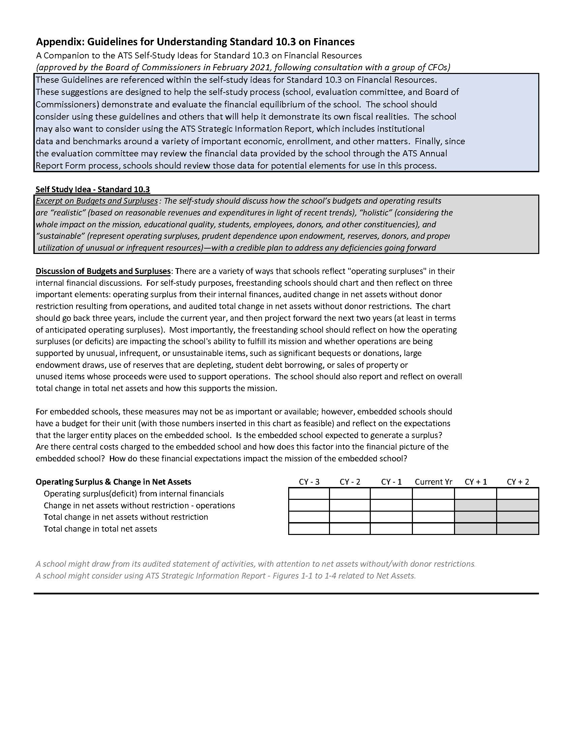
Note
“Guidelines for Understanding Standard 10.3 on Finances” on ats.edu web page > Petitions/Notifications/Guidelines
How many years should we cover?
14

Slide 15
Supporting data (evidence/documents)
Weak report: “Most of our MDiv students are placed.”
Good report: “Over the last five years our MDiv graduates have averaged a 90% placement rate, with a steady increase each year, as Table 4.1 shows.”
A benchmark against other peers would be helpful here
15

Slide 16
(3) Evaluation of data [objectively & honestly]
When the whole nation had finished crossing the Jordan . . . Joshua set up at Gilgal the twelve stones they had taken out of the Jordan. He said to the Israelites, “In the future when your descendants ask their parents, ‘What do these stones mean?’ tell them, ‘Israel crossed the Jordan on dry ground.’” (Joshua 4)
Tell (the story) of what the supporting data means to the school!
So what??? What can the school learn from the data??
16

Slide 17
Evaluation of data [objectively & honestly]
Weak report: “We try hard not to spend more than we take in.”
Good report: “The seminary has balanced its budget four of the last five years, as Table 8.6 below demonstrates. The deficit of $74,892 in FY24 represented only a 2.5% overage due to an unexpected need to replace a furnace. We have since established a ‘contingency fund’ for such emergencies, with a line-item budget of $50,000 per year.”
17

Slide 18
Evaluation of data [objectively & honestly]
What about dissent?
A minority report?
Weak report: “Morale on campus is much better.”
Good report: “Three years ago faculty morale hit a low point when a doctrinal controversy led to the dismissal of a popular professor. The seminary followed its procedures (documented in our personnel files), but it was a very difficult time. Since then, the board and administration have worked hard to rebuild unity, with significant success—as noted in the recent faculty survey (see 2025 Faculty Survey, item #8).”
18

Slide 19
4) Recommendations informed by data toward continued educational effectiveness
Strategic
Specific
Succinct
Obtainable (vs aspirational)
What next steps will the school take based on what it has learned, to be more effective educationally and institutionally (achieve our mission)?
19

Slide 20
Recommendations informed by data
Weak report: “We know more should be done to address our lack of board diversity, and we are working on that.”
Good report: “Given our global mission and given that one fourth of our students and staff are from under-represented groups, and while no one on the board is, our trustees have set a goal of recruiting one new trustee each year from an under-represented group for the next five years until our board more fairly represents our constituency and our mission. Our first African American trustee will begin her term this fall.”
20

Slide 21
Recommendations informed by data
Weak report: “Enrollment has been declining dramatically. We have developed 15 initiatives to increase enrollment 15% each year until we reach 2007 peak enrollment levels.”
Good report: “Given our declining enrollment, we have identified three under-served population churches within 15 miles of the school that we have developed an MOU with to offer our Master of Ministry degree at a discounted rate over the next three years.”
21

Slide 22
5) In the school’s mission and context
Your mission
Your context
Attending to these themes found throughout the Standards
Evaluation (assessment – institutional and programmatic) (Standards 1.2, Standard 2, 3.7, 3.9, 3.12, 4.0, 4.5, 4.9, 4.12, 5.0, 5.4, 5.6, 5.10, 5.16, 6.1, 6.2, 6.5, 6.8, 7.5, 8.1, 8.5, 8.7, 8.9, 8.10, 9.0, 9.3, 9.5, 9.6, 9.9, 10.2, 10.3)
a) identify outcomes, b) gather evidence, c) analyze & reflect, d) use analysis for improvement (2.6)
Global awareness and engagement (Standards 1.4, 3.0, 3.4, 4.3, 6.7, 8.8)
“demonstrate in student learning and formation” (3.4)
Diversity (Standards 1.0, 1.5, 3.3, 6.7, 7.3, 7.5, 8.0, 8.2, 8.8, 9.2, 9.9, 10.1)
“publicly available stance on diversity . . . within [the school’s] mission, history, constituency,
theological commitments” (1.5)
Mission (Standard 1, Standards 2.2, 2.5, 3.1, 3.6, 4.8, 4.11, 5.3, 5.9, 5.13, 7.0, 7.3, 7.10, 8.6, 8.7, 8.10, 9.1, 9.2, 9.3, 9.4, 9.5, 10.1, 10.3, 10.5, 10.7, 10.9)
“appropriate to graduate theological education and its own context and constituencies” (1.1)
22

Slide 23
For the dissenters who wonder –
Why accreditation?
Excursus: Why ATS accreditation?
Some denominations require an MDiv from an ATS school for ordination
A MDiv degree from an ATS accredited school is required/highly recommended for military (and some other) chaplaincies
Demonstrates credibility to your publics through peer review (students, donors, peer institutions)
ATS is recognized as the “gold standard” accreditor for North American theological ed (as reported by those applying for membership)
ATS is a “gatekeeper” to Title IV federal financial aid for ~60 schools to the tune of $41M
To ensure “compliance” with USDE educational expectations, whether a Title IV school or not
ATS membership is necessary for access to some granting organizations (Lilly)
We collaborate data and provide professional development resources for the benefit of our members!
Five faith-based accrediting associations recognized by the USDE
  ABHE - The Association for Biblical Higher Education, Commission on Accreditation
  AARTS - Association of Advanced Rabbinical and Talmudic Schools, Accreditation Commission
  AIJS - Association of Institutions of Jewish Studies
  COA-ATS - Commission on Accrediting of the Association of Theological Schools
  TRACS - Transnational Association of Christian Colleges and Schools, Accreditation Commission
23

Slide 24
Formative Assessment – QUIZ – T or F
The narrative-description, evaluation-analysis, and action points-recommendations need to be informed by presented evidence.
The best SS are those completed by professional consultants outside the institution.
Of the three parts of the SS, the evaluation section should be the shortest if included at all.
The best SS repeats the entire text of the Standards in the narrative.
SS ignore a school’s mission and context and examine the data objectively.
24

Slide 25
Formative Assessment – QUIZ – T or F
The purpose of the SS is to tell the school’s story well.
The school’s liaison should be avoided at all costs during the SS process.
The best SS contain two parts: description and analysis.
(a) description, (b) data-evaluation, (c) recommendations -- in light of the school’s mission and context -- form the outline of the SS.
A SS’s recommendations are those received anecdotally by insightful senior faculty during the SS process.
25

Slide 26
The Self-Study Report . . .
The specific report structure
Organization and length
  Introductory chapter
  School synopsis
  Main narrative
  Concluding chapter
Required appendixes
Supplemental materials
26

Slide 27
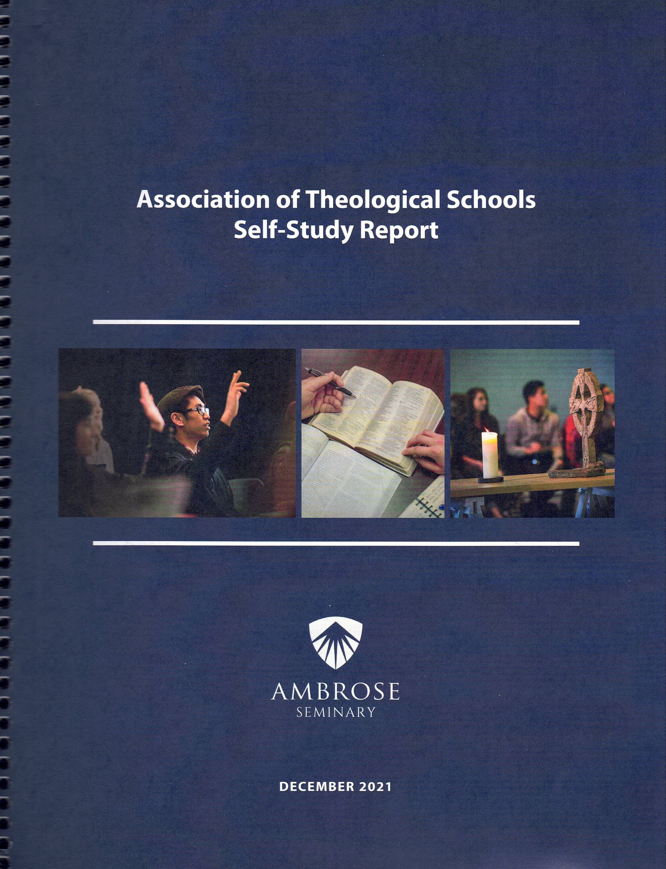
The specific report structure
Four parts of report
  Introductory chapter (5-8 pages)
  School synopsis (1-2 pp)
  Main narrative (50-80 pp)
  Concluding chapter (4-5 pp)
  TOTAL 65-100 pp
Required appendixes – PDF flash drive only
Supplemental materials – Online and/or Resource Room
Print and
PDF on flash drive
27

Slide 28
Part 1. Introductory chapter (5-8 pp)
Sets context for entire self-study report
Title page with name of school and date of visit
Possibly a Preface with list of abbreviations or other orienting materials
Briefly introduce the school
  mission/context/history/ecclesial-denominational commitments
  Special qualities/programs/uniqueness of the school
Summarize major changes since last comprehensive visit
Review accreditation history (since last visit)
  Including school’s response to the last evaluation committee recommendations from full report
  Any additional action items from the ATS Board of Commissioners
Give overview of the design and process of the self-study process
  Description of committee structure
  How school involved broad participation of stakeholders in the process
Often written last
28

Slide 29
Part 2. School synopsis (1-2 pp)
List all degrees (# credits, # students)
List all additional locations (% of degree)
List all modalities (onsite, online, offsite)
Number of faculty/staff (FT & PT), trustees
Relationship with any denomination(s)
List of any other accrediting agencies
Link to school’s announcement about visit
Link to school’s statement of accreditation
Indication of whether school participates in Title IV & gatekeeper
See Self-Study Handbook (pp 22) for details
Nice tables are a plus!
Often written last
(so it is up-to-date)
29

Slide 30
Part 3. Main narrative (50-80 pp)
5-8 pp per Standard (except 4 & 5)
Mission and Integrity
Planning and Evaluation
Student Learning and Formation
Master’s Degrees (unpack)
Doctoral Degrees (unpack)
6. Library Services
7. Student Services
8. Faculty
9. Governance and Administration
10. Institutional Resources
Include all 10 chapters, even if #5 does not apply.
Say, “5. Doctoral Degrees: The school has no doctoral programs.”
30

Slide 31
Main narrative (50-80 pp)
3-5 pp per degree program
4. Master’s Degrees (unpack)
4.1-5 Master of Divinity
4.6-9 Master of Arts [each MA program, identify academic and/or professional oriented]
4.10-12 Master of Theology (ThM/STM)
5. Doctoral Degrees (unpack)
5.1-6 Doctor of Ministry
5.7-10 Other Professional Dr [each professional doc program]
5.11-16 Doctor of Philosophy / Theology [each academic doc program]
If more than one MA or Professional Doctorate, the Self-Study may discuss them together or separately, depending on degree structure. If one of these six groupings is not offered, indicate that in the report (e.g., “The school does not offer the ThM, so Standards 4.10-12 are not applicable.”) NOTE: See Self-Study Handbook, p. 22.
31

Slide 32
Chapter tips . . .
Remember the 5 Keys!
Sufficient description – what resources support us meeting this Standard?
Supporting data (evidence/documents) – what evidence demonstrates us meeting this Standard?
Evaluation of data – what assessment of this evidence has taken place?
Informed recommendations – what strategic recommendations would improve our alignment with this Standard?
Remember: In the school’s mission & context.
Refer to the Standards with Self-Study Ideas!
Ensure you address the “requirements” (coming up)
End each chapter with an INFORMED brief summary of strengths, areas for needed growth, and recommendations for next steps!
32

Slide 33
Chapter tips . . .
Some Key Words:
Tell your school’s story of how it works and why
(not merely description!)
For example . . .
This is evidenced by . . .
See document [xyz] . . .
For instance . . .
Another example is . . .
Write for the Reader (BOC) who will have only the SS and Appendix
to read!!
33

Slide 34
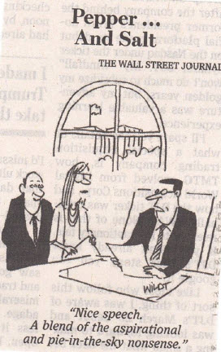
Part 4. Concluding chapter
34

Slide 35
Part 4. Concluding chapter (4-5 pp)
Summarize overall findings of the self-study; what has school learned?
Organize and prioritize strengths to be sustained
Organize and prioritize concerns or areas needing improvement toward greater educational effectiveness
  If the self-study has concluded the school is at risk of not meeting, does not fully meet, or does not meet one or more of the Standards – describe how the school is already implementing a credible plan to meet the Standard in the near future
Organize and prioritize recommendations that have emerged in the self-study process and how the school plans to continue its process of self-evaluation through the next period of accreditation
Perhaps 4-7,
not 40-70
See p 23 of SS HB
35

Slide 36
Required appendices
Limited to these seven (or eight) Appendices
Bookmarked, single PDF file on flash drive (no hard copy)
Current organizational chart, showing names and titles
Current strategic plan(s)
Current evaluation plan(s) (summarize results in report)
Current budget (if embedded, just unit) and a 3-5-year budget plan
Most recent fiscal year audit (and management letter, if one)
Handbooks: Board, faculty, staff, and student
Academic catalog (include as bookmarked PDF)
US Title IV documentation – Appendix B (if applicable)
Remember, you may elect to link to numerous documents and websites to amplify and support your narrative text but limit your Appendices to these items.
36

Slide 37
Supplemental materials
See pp 25 of SS HB for list of other items (e.g., syllabi, minutes, CVs, publications, promotional materials, etc.)
School may choose to make these available in format they prefer -- PW protected web page, USB drive, file-share, hard copies in Resource Room, etc.
  Best Practice – include most materials in a folder labeled “Supplemental Materials”>individual folders labeled by Standard on the thumb drive
ENSURE THEY ARE READILY ACCESSIBLE!!
        AVOID COMPLICATED TECHNOLOGY!!
37

Slide 38
Self-Study Submission Deadlines
60 days before the visit to the liaison and Commission office (p 26)
  Liaison will review to ensure completeness & meets Commission expectations
  45 days before the visit to the committee
Initial accreditation – Board approval of SS to authorize the visit (p 27)
  November 1 for winter (Feb) Board meeting
  with potential visit in spring of that year
  April 1 for summer (June) Board meeting
  with potential visit in fall of that year
  Communicate with your liaison!
  45 days before the visit to the committee
38

Slide 39

Gentle Reminders
Attend carefully to descriptions & evaluation of varying modalities (such as distance ed or CBTE) and to additional locations (Standard 3, etc.)
Ensure Pathways initiatives are evaluated in light of the Standards when relevant
And that funding is clear and not simply bolstering the fiscal stability of the institution (Standard 10)
39

Slide 40
Things to Consider re: AI Software or Gen AI Tools
Human control
Authenticity of data
Transparency and accountability
Protection and security
Reliability of AI systems
      From CHEA Guiding Principles for Artificial Intelligence in Accreditation and Recognition, February 18, 2025
40

Slide 41
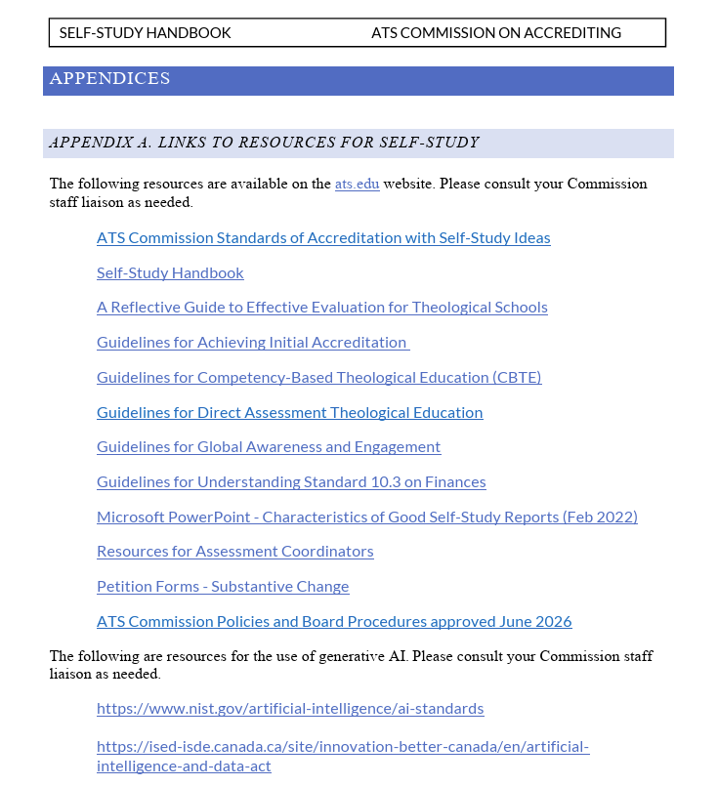
A NEW Appendix A
Resource Links
41

Slide 42
REQUIRED for US Title IV Participants
(whether ATS is the “gatekeeper” or another agency)
Appendix B
42

Slide 43
Title IV School Participants
Standard 1.6 requires that “any school that participates in US federal student aid programs meets all government regulations for those programs.” Those regulations are identified in the Self-Study Ideas in the seven Standards listed below.
INCLUDE EVIDENCE of state, NC-SARA, etc. authority to operate and confer degrees for all locations! (Standard 1.6)
Info
ATS is the Title IV “gatekeeper” for ~60 member schools
Accessing about $41M in federal financial aid in AY 2023
About 1/3 of ATS 280 school are not Title IV participants (30 in Canada)
43

Slide 44
Title IV School Participants
1. Standard 3.2 on Academic Rigor
While every school must demonstrate academic rigor, a Title IV school must document how it meets the federal definition of a credit hour (34 CFR §600.2). To verify that it does, the school must provide to the evaluation committee a sampling of syllabi that represent all types of courses, course lengths, degree programs, and delivery modalities.
34 CFR 600.2 “Credit hour:”
Credit hour: Except as provided in 34 CFR 668.8(k) and (l), a credit hour is an amount of student work defined by an institution, as approved by the institution's accrediting agency or State approval agency, that is consistent with commonly accepted practice in postsecondary education and that -
(1) Reasonably approximates not less than -
  (i) One hour of classroom or direct faculty instruction and a minimum of two hours of out-of-class student work each week for approximately fifteen weeks for one semester or trimester hour of credit, or ten to twelve weeks for one quarter hour of credit, or the equivalent amount of work over a different period of time; or
  (ii) At least an equivalent amount of work as required in paragraph (1)(i) of this definition for other academic activities as established by the institution, including laboratory work, internships, practica, studio work, and other academic work leading to the award of credit hours; and
(2) Permits an institution, in determining the amount of work associated with a credit hour, to take into account a variety of delivery methods, measurements of student work, academic calendars, disciplines, and degree levels.
See ats.edu>Accreditation>Accreditation Terms
44

Slide 45
Title IV School Participants
2. Standard 3.11 on Educational Policies
While every school must have and follow the policies described in this Standard, a Title IV school must also demonstrate it has and follows a “Satisfactory Academic Progress” policy.
3. Standard 3.12 on Transfer of Credit Policy
While every school must have and follow an appropriate transfer of credit policy, a Title IV school must also document any articulation agreements for transfer of credits with other accredited schools or any contracts with non-accredited entities to provide up to one-fourth of a degree.
4. Standard 7.5 on Student Safety
While every school must provide a safe environment for students, a Title IV school must also document that it meets the Clery Act for campus security and fire safety.
5. Standard 7.9 on Student Debt
While every school must regularly review student educational debt and develop strategies as needed to reduce debt, a Title IV school must also provide its most recent federal student loan cohort default rate and its response to any excessive default rate.
National avrg is 7.3%
ATS avrg around 4%
45

Slide 46
Title IV School Participants
6. Standard 7.11 on Placement
While every school must monitor placement rates, a Title IV school that uses those rates for marketing or recruitment purposes (excluding its public statement of educational effectiveness, per Standard 2.8) must document that those rates have been verified by an external entity.
7. Standard 10.7 on Financial Aid Audits
While every school must conduct an independent audit every year of its institutional finances, a Title IV school must also provide a copy of its most recent federal financial aid audit and its response to any findings. If the school has a “financial responsibility composite score” below 1.5, as determined by the US Department of Education (USDE), the school must provide a copy of that USDE letter and the school’s response (e.g., posting a letter of credit, being subject to cash monitoring).
46

Slide 47
III. PRODUCES RESULTS
It tells your story well
The visiting evaluation committee says, “we understand this school”
The school says, “they understand us”
Which in turn leads to progress toward . . .
Internal goals – identified issues and strategic planning to address issues for greater effectiveness
External goals – demonstrated educational quality to (ATS) peers and quality assurance to public(s)
Eternal goals – clearer fulfillment of your school’s mission
47

Slide 48
Summative Assessment – QUIZ – T or F
Ensure that all hyperlinks are active and lead to the correct evidence.
Schools should pick the five easiest Standards to write to.
The final chapter should include at least 43 action point/recommendations.
The BOC will read the SS and Appendices together with the visiting Committee’s report and draw their own conclusions.
Evidence not available in the Appendix or Supplemental Materials is not important.
Students should not participate in the SS process.
48

Slide 49
Summative Assessment – QUIZ – T or F
Description should drive the SS narrative.
The concluding summary chapter is largely irrelevant.
All supplemental materials will be available for BOC members’ evaluation of the visit.
Title IV has nothing to do with the Standards.
BONUS
** Writers should ignore the SS Handbook guidance.
** The highest compliment paid by the committee is – “We understand this school” and by the school “The committee understands us.”
49

Slide 50
Thank you!!
Your liaison is an available resource to answer questions and clarify the self-study process!
50

